Slide 1
Electronics & Electricity
Unit 9 – What is arduino
Section 2 – Blink A LED

Slide 2
Blink A LED
What is arduino

Slide 3
The big idea
Breadboard circuit prototyping
Applying code through Arduino IDE
Rapid prototyping
Code, electronics, and prototyping
Building models to test

Slide 4
Arduino

Slide 5
What is Arduino?
Arduino is an open-source electronics platform based on easy-to-use hardware and software
Arduino boards are able to read inputs - light on a sensor, a finger on a button, or a Twitter message - and turn it into an output - activating a motor, turning on an LED, publishing something online
You can tell your board what to do by sending a set of instructions to the microcontroller on the board
To do so you use the Arduino programming language (based on Wiring), and the Arduino Software (IDE), based on Processing

Slide 6
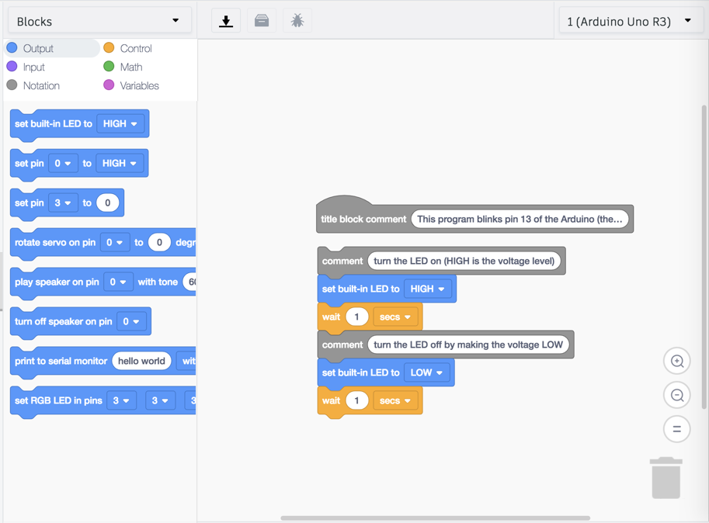
BLINK A LED
HERE this TinkerCAD project will go over how to Blink an LED through the Digital Output of the Arduino board
Rather then working through a regular code editor, simple block doing will be used

Slide 7
Add-On
Try and alter the time the LED stays on for both the built-in LED and connected LED
REMEMBER: The built-in LED used the block code while the LED component used the text code

Slide 8
Blink Multiple LED Code Example
//START OF CODE
int led = 13; int led2 = 12; int led3 = 11;

Slide 9
Blink Multiple LED Code Example
// the setup routine runs once when you press reset:
void setup() {
// initialize the digital pin as an output.
pinMode(led, OUTPUT); pinMode(led2, OUTPUT); pinMode(led3, OUTPUT); }

Slide 10
Blink Multiple LED Code Example
// the loop routine runs over and over again FOREVER:
void loop() { digitalWrite(led, HIGH);
delay(100);
digitalWrite(led, LOW); delay(100); {digitalWrite(led2, HIGH); delay(100); digitalWrite(led2, LOW); delay(100);} {digitalWrite(led3, HIGH); delay(100); digitalWrite(led3, LOW); delay(100);} }
// END OF CODE

